Slide 1


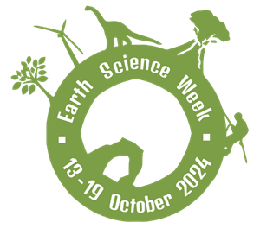

‘Earth Science Everywhere’
13 – 19 October 2024

Slide 2



Earth Science Week celebrates earth science!
It is the chance for everyone to discover and learn about the earth sciences.

Slide 3
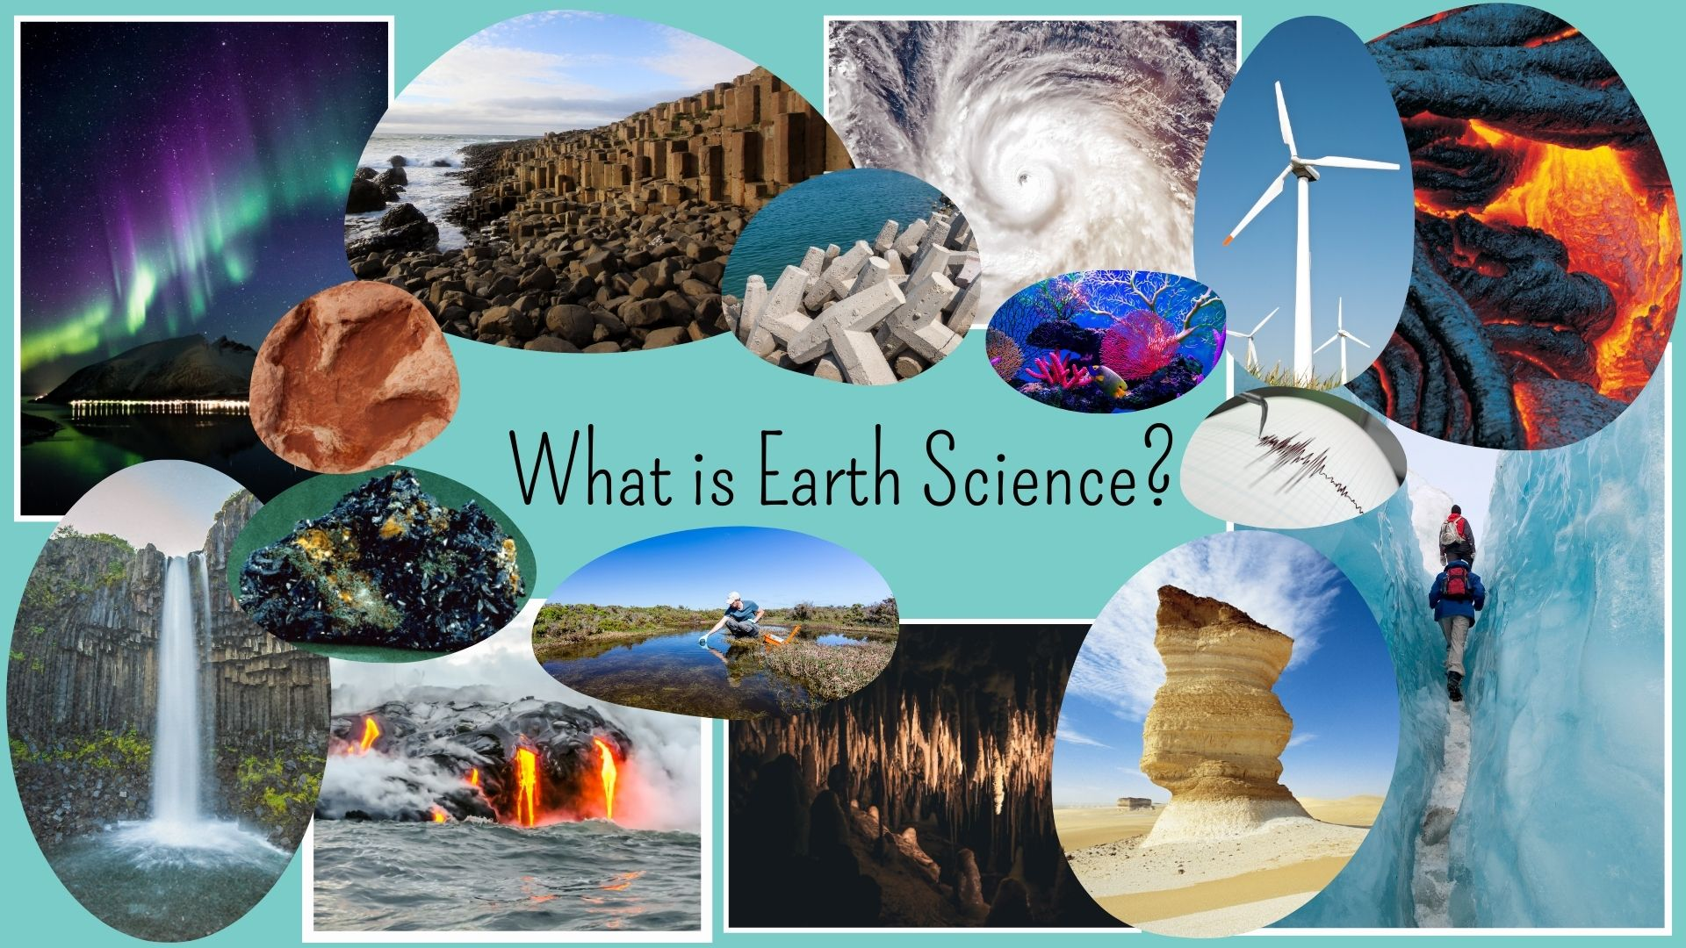
Notes:
Ask the students to look at the different images:
What do they recognise?
Can they name any of the areas of science on display?
What images surprised them as being earth science?
Images included (clockwise from top left corner):
Northern Lights (geomagnetism)
Giants Causeway (hexagonal basalt)
Coastal defences
Tropical storm system
Coral reef
Wind turbine
Lava flow
Seismometer (earthquake monitoring)
Glaciers
Rock pedestal (desert)
Stalagmites (cave systems)
River water sampling
Basaltic lava fission
Waterfall
Azurite mineral specimen
Dinosaur footprint (fossil)

Slide 4

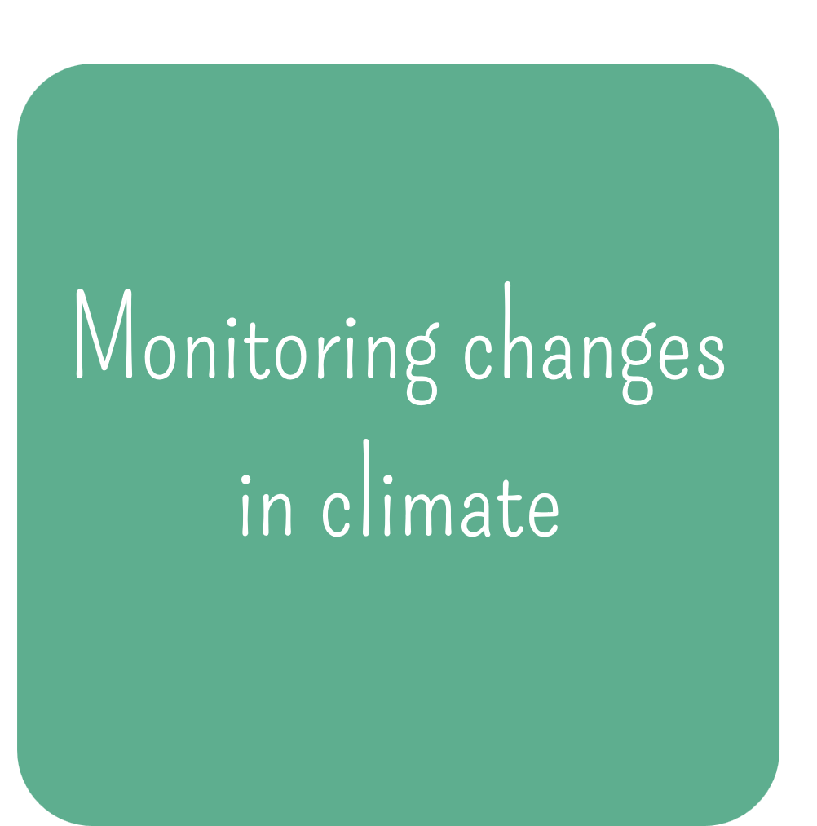
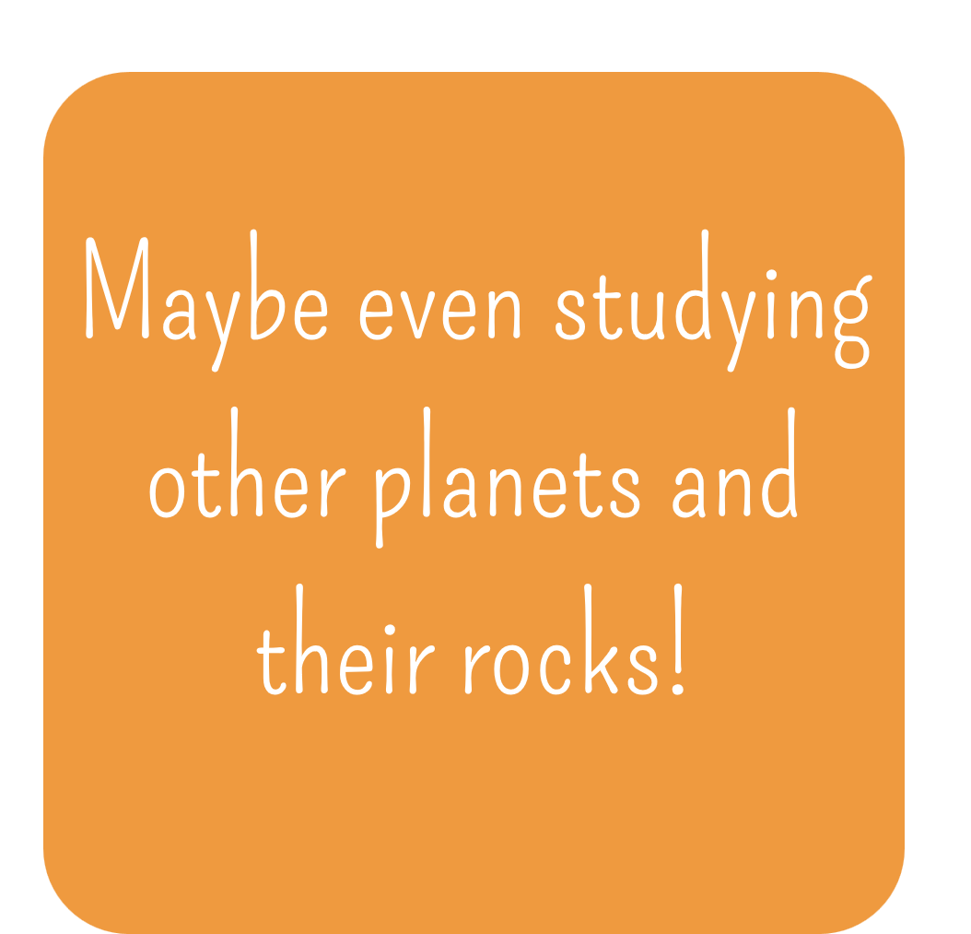
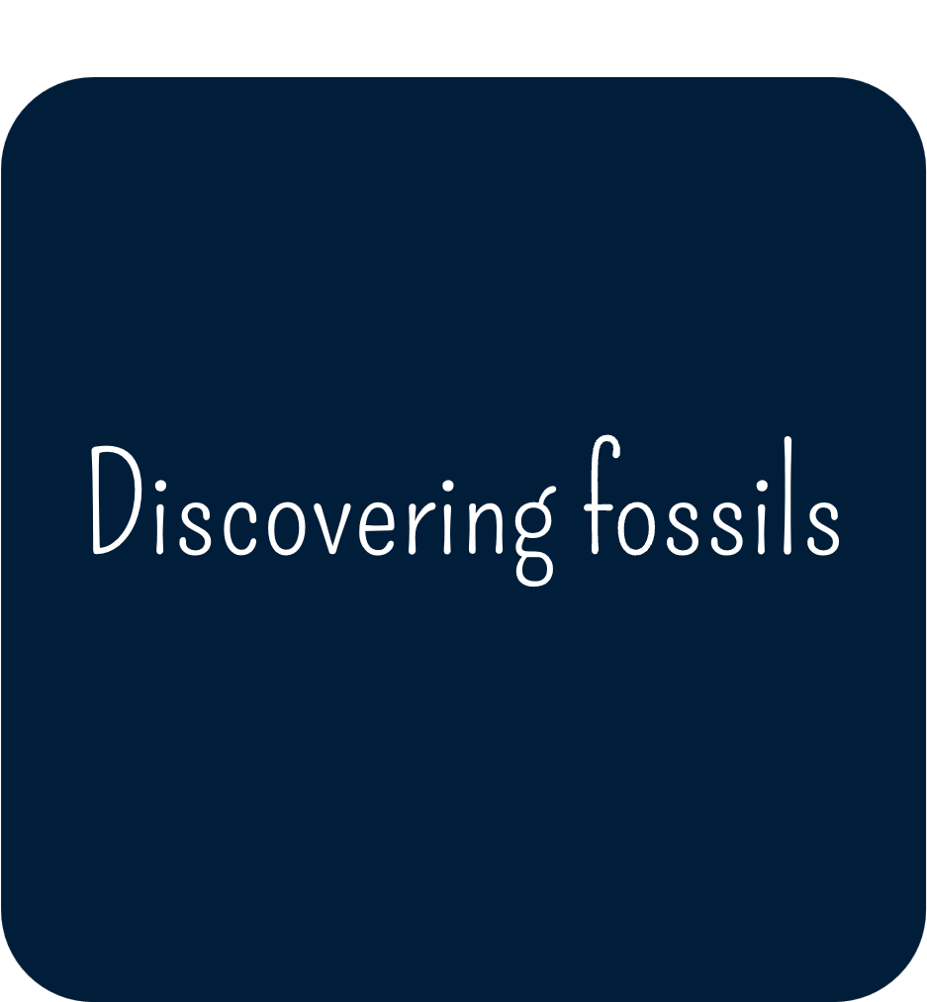
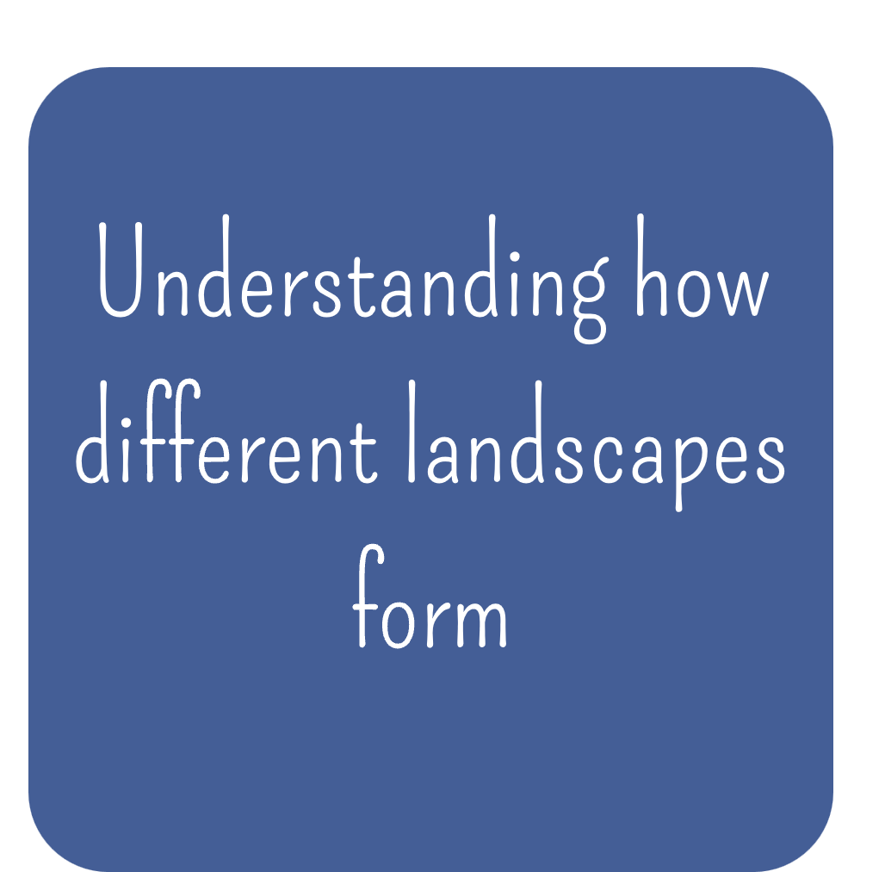
Lots of different things! An earth scientist will be interested in studying the Earth in different ways:
Notes:
Ask the students of what they think earth scientists are interested in based on what they have seen from the images before. See if they can guess the names of any jobs that an earth scientist might have.
The next three slides cover 3 possible jobs for them to learn about.

Slide 5

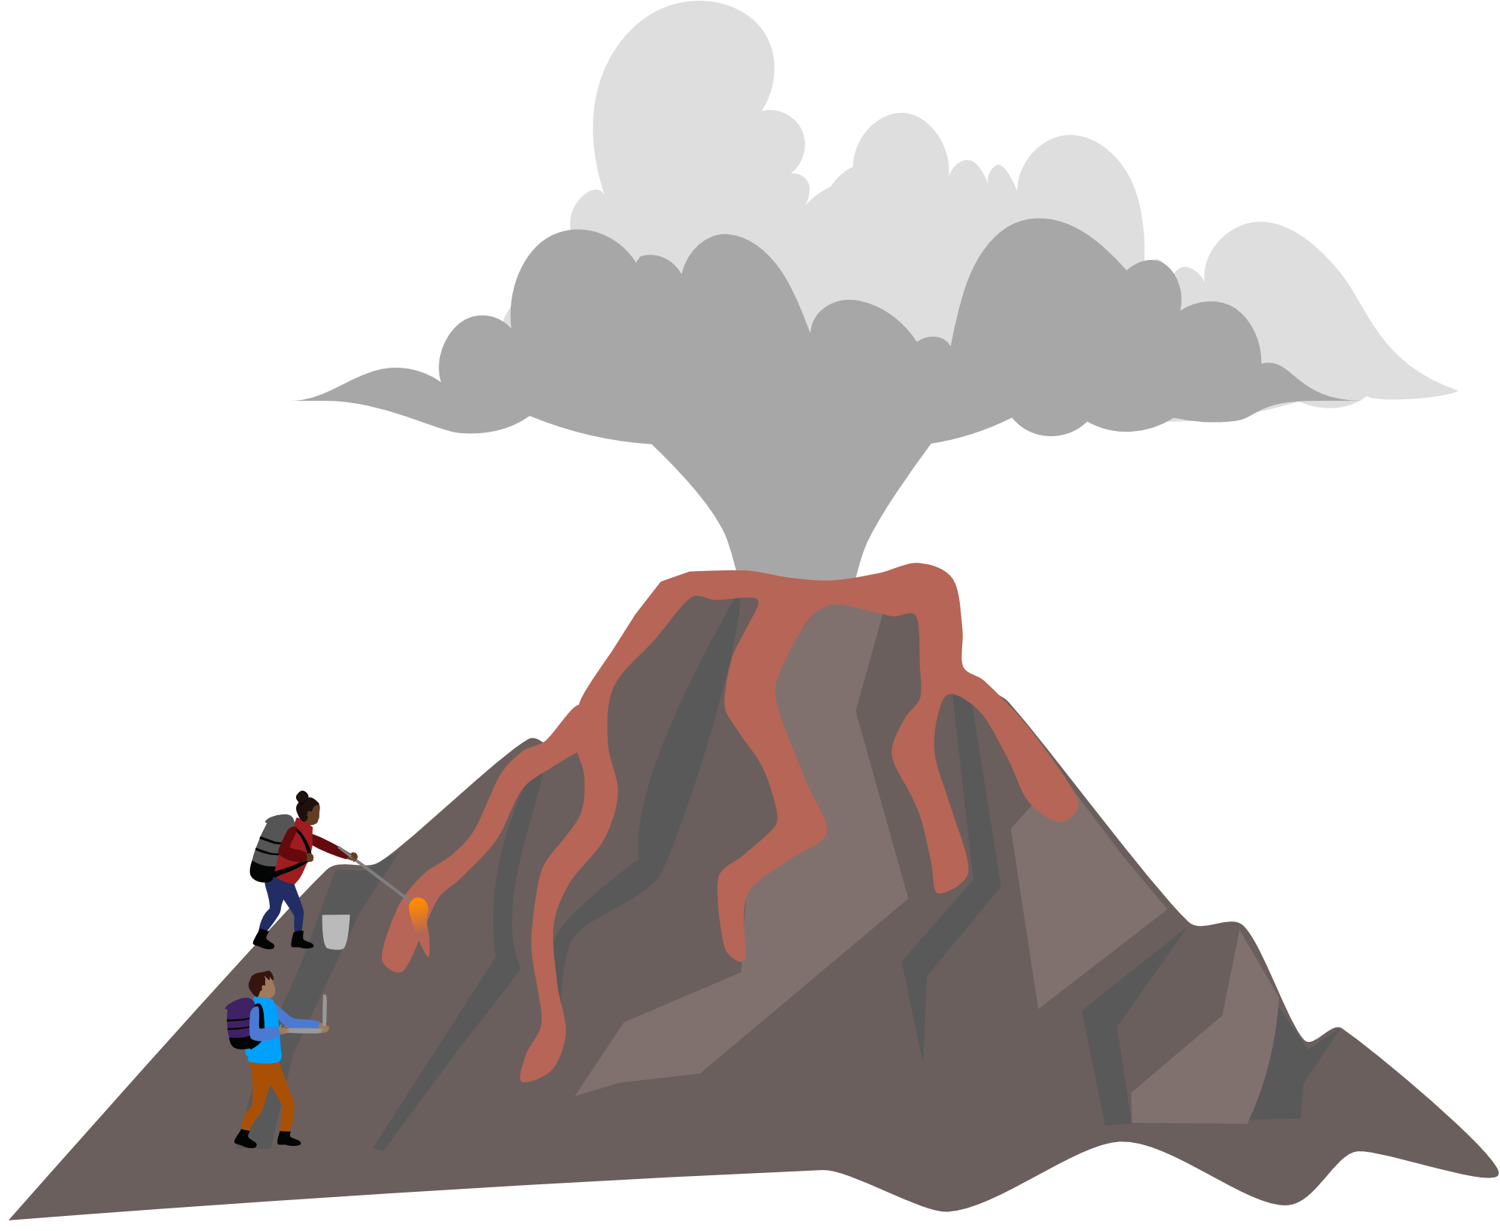
Volcanologists study volcanoes all over the world!
They monitor volcanoes to work out when they will erupt by looking for early warning signs. For example, the ground swelling, releasing gases or steam, and feeling earthquakes.
Volcanologists help protect people from hazards
such as lava and ash, by forecasting eruptions
and how big they might be.

Slide 6

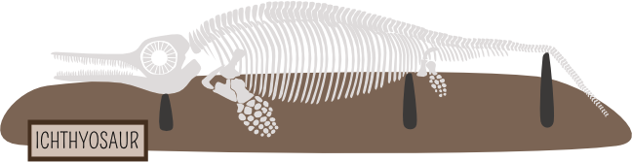
Palaeontologists are scientists who study the history of life on earth through fossils. A paleontologist will want to find out what life was like on earth millions of years ago, also to understand how animals and plants have evolved.
There are two types of fossils: body fossils and trace fossils.
Body fossils are plant and animal remains like leaves, shells, and bones.
Trace fossils are evidence left behind by animals, things like footprints, burrows and even poo!

Slide 7


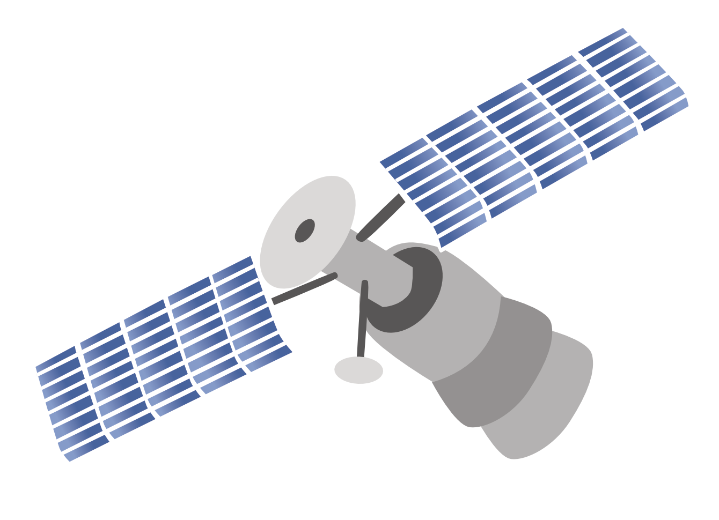


Planetary scientists study planets, moons and asteroids in space! They want to learn what other planets and moons are made of and how they formed.
This includes working out what rocks there are, what the
weather is like, and how landscapes form on other planets.
They can do this from space missions to collect
rock samples but also from satellite images
where they can compare them to
landscapes here on earth!

Slide 8

Now you’ve seen what some scientists do, if you were one what would you do?
If you like playing in the rain – you might like working out how weather affects landscapes
If you like collecting cool rocks – you might like learning about the minerals that make up a rock
If you like going to the park – you might like discovering new plants and finding out where they grow
Notes:
This short activity can be done as a whole class or in small groups. It is the chance for students to think about what they are interested in and see how that could be a part of earth science! The above examples are to help them think of their answers so it relates to what they like to do.

